Slide 1
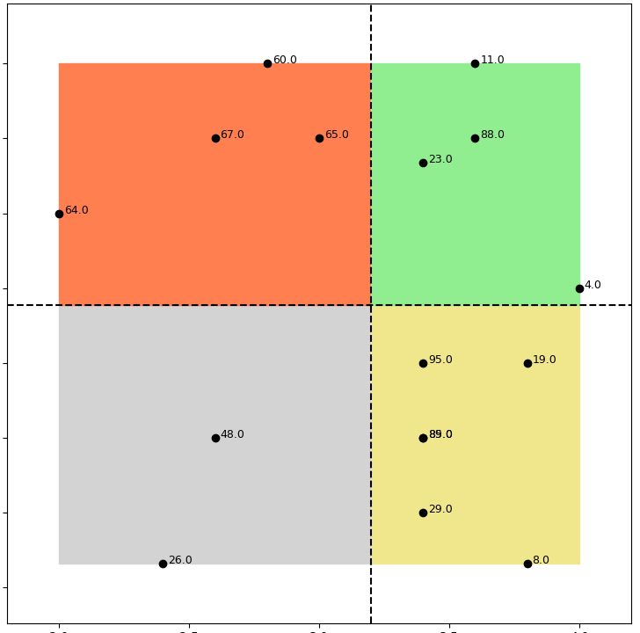
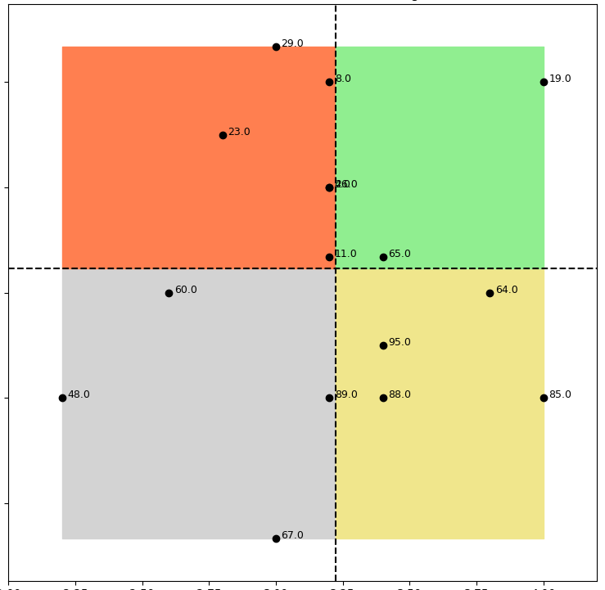
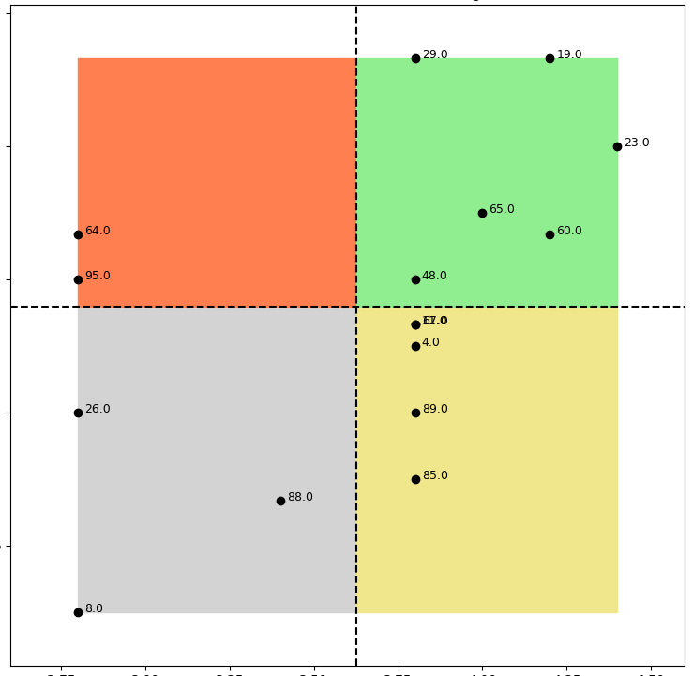
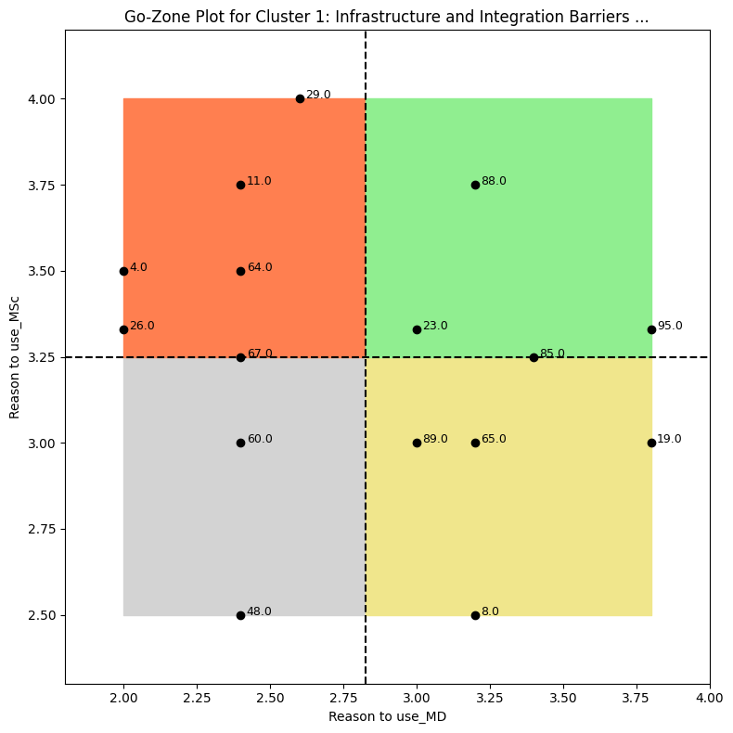
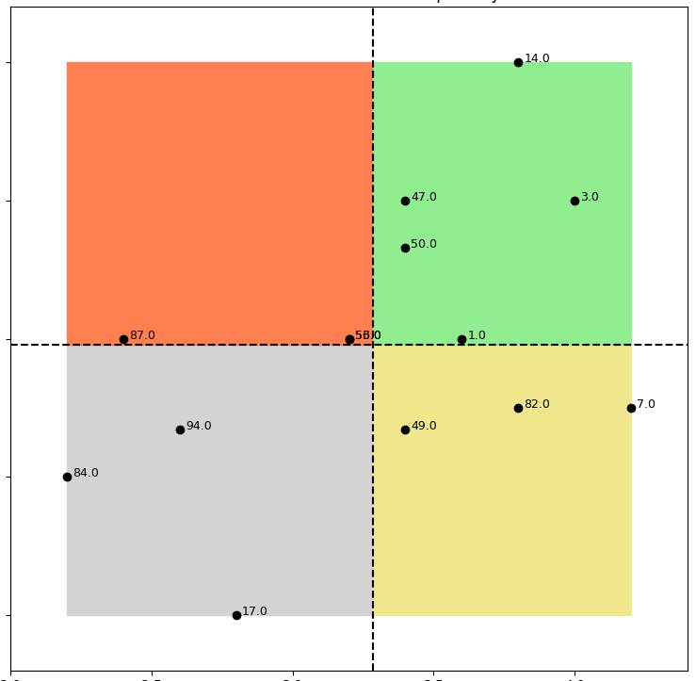
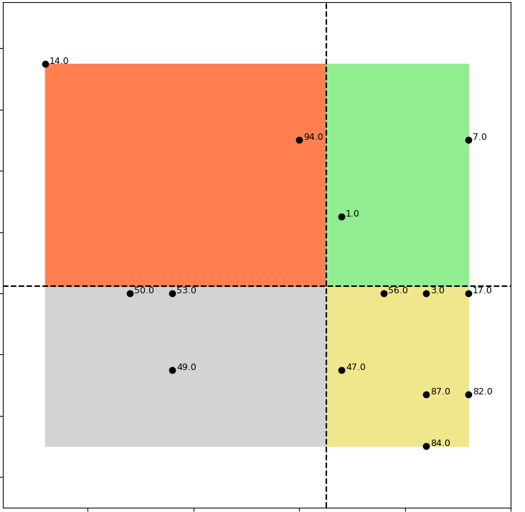
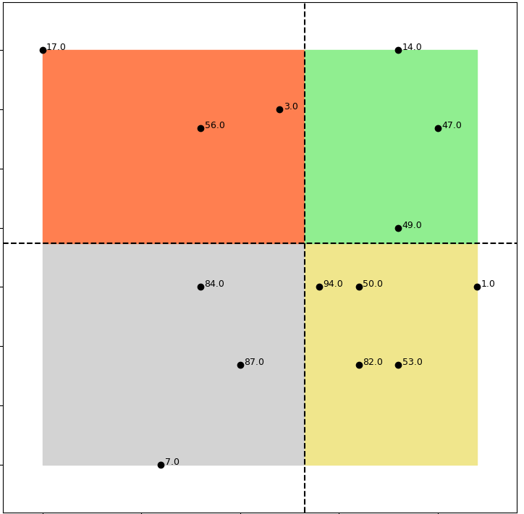
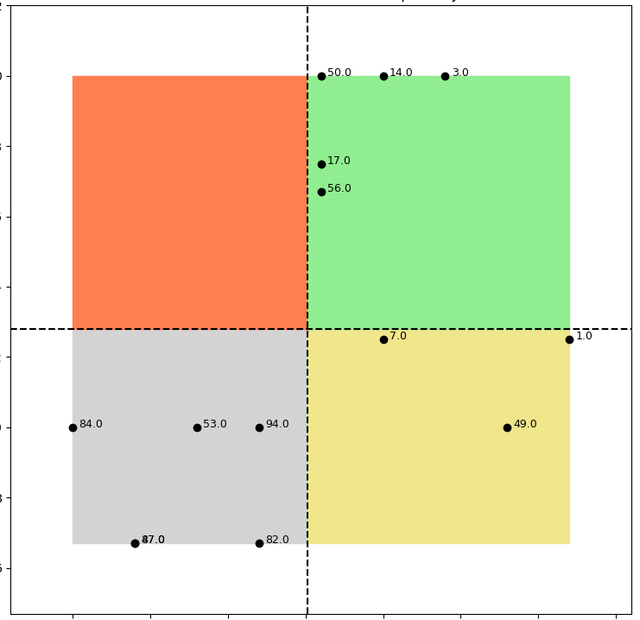
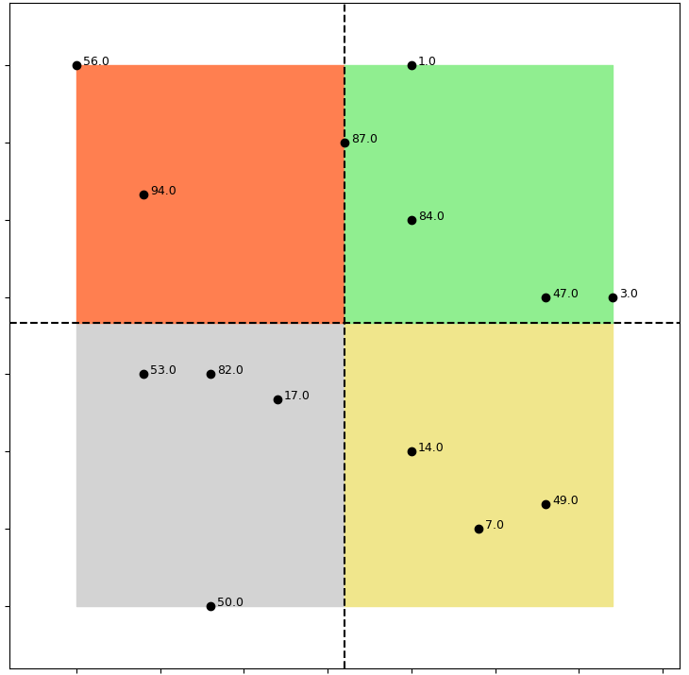
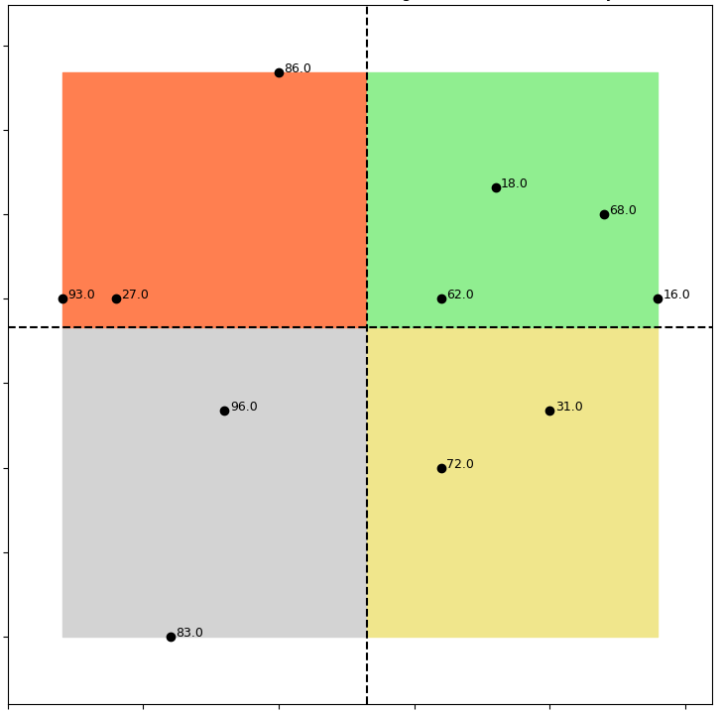
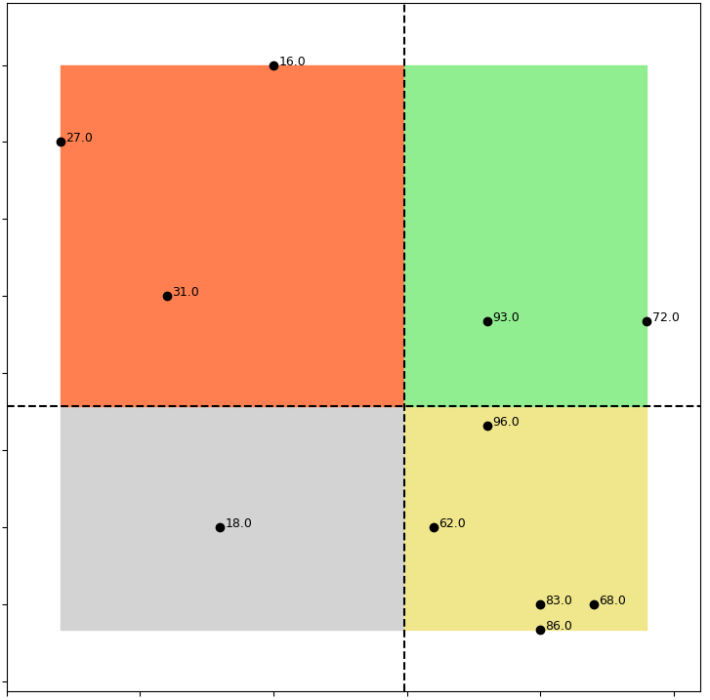
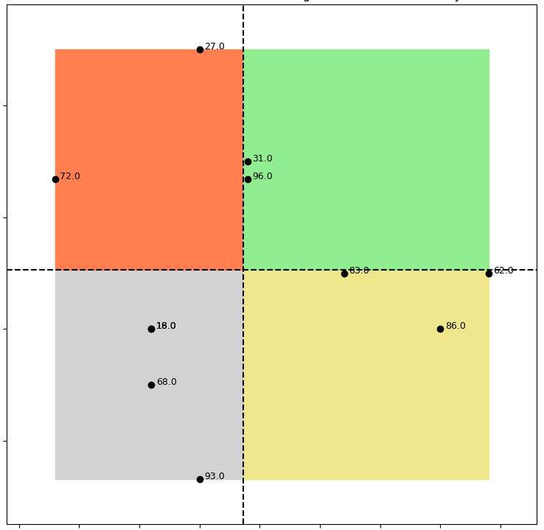
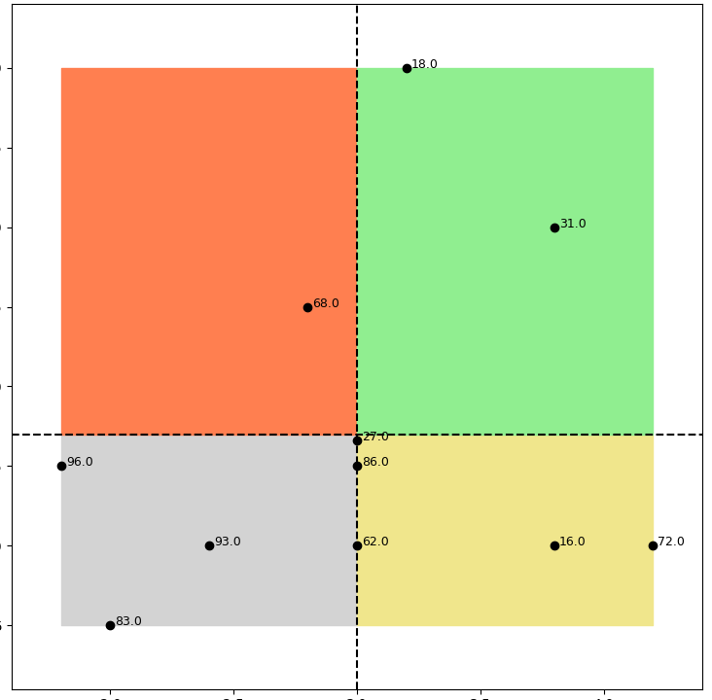
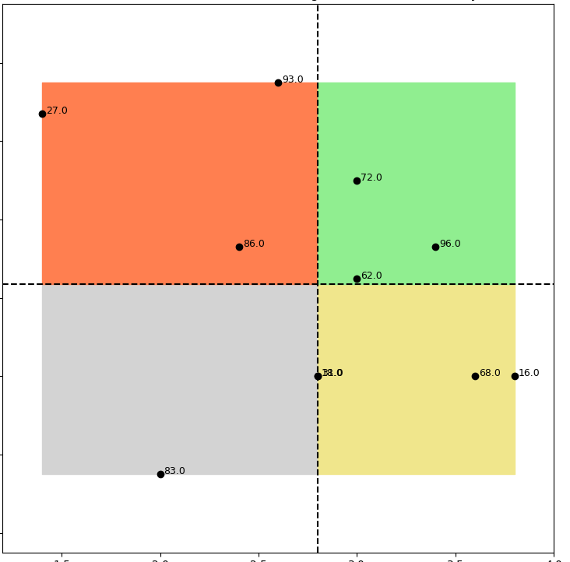
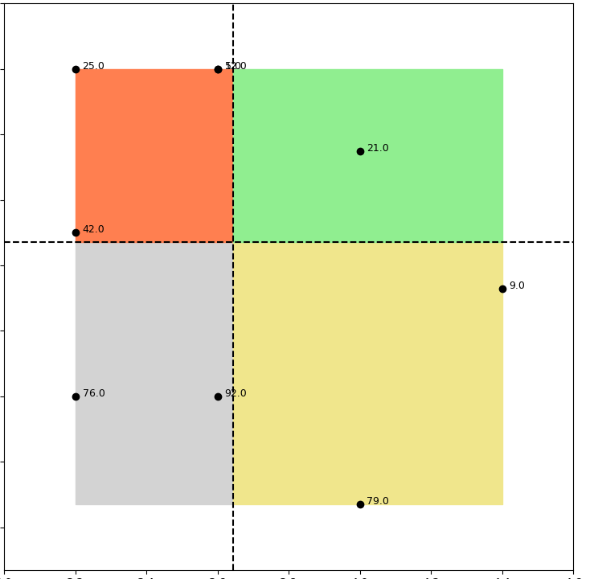
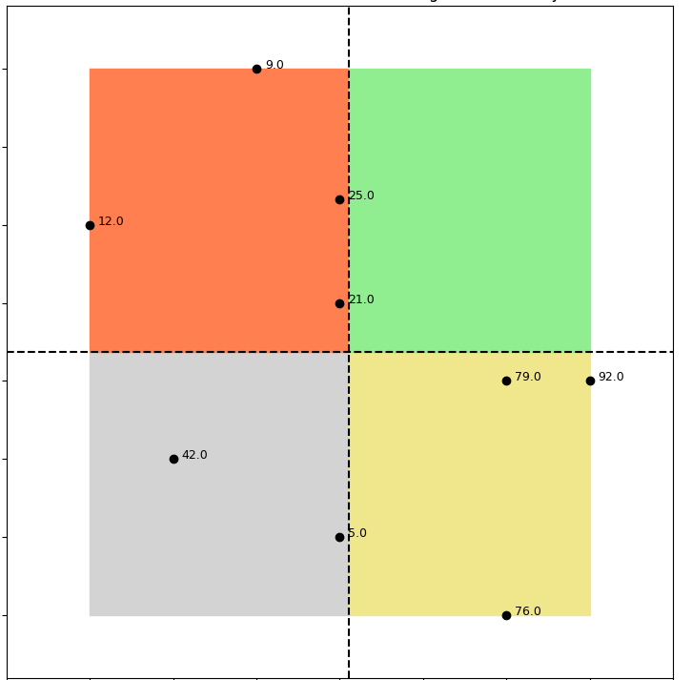
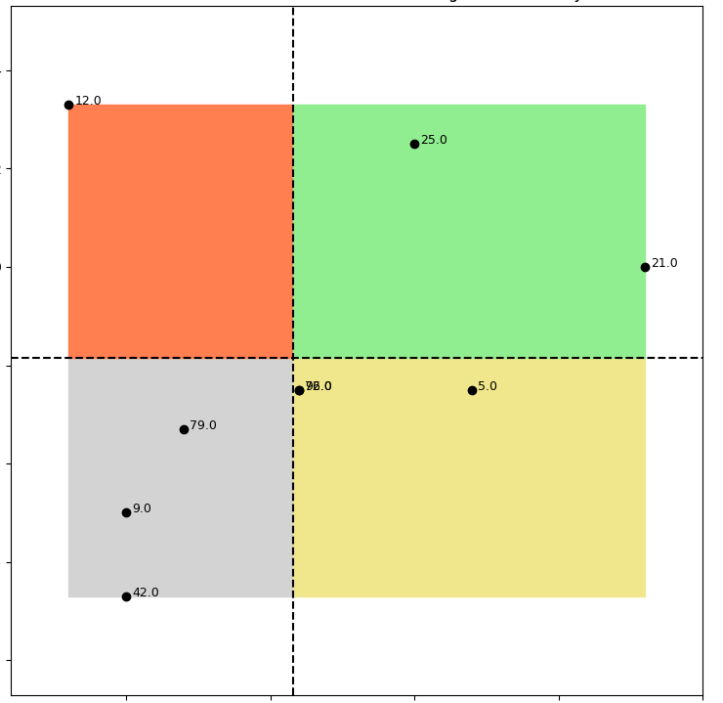
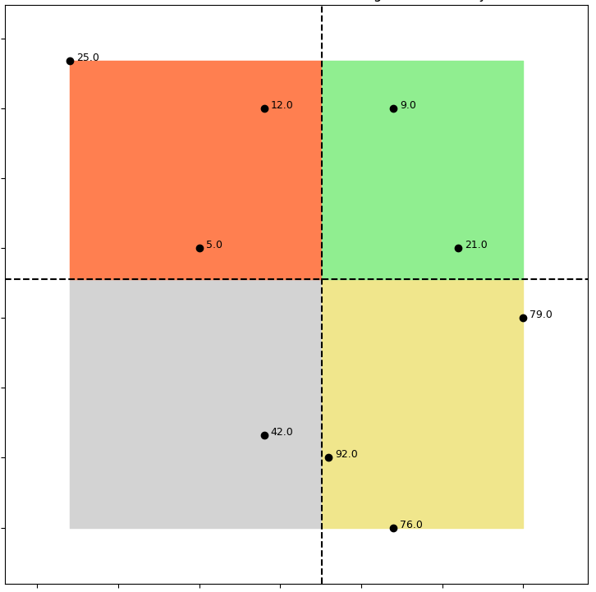
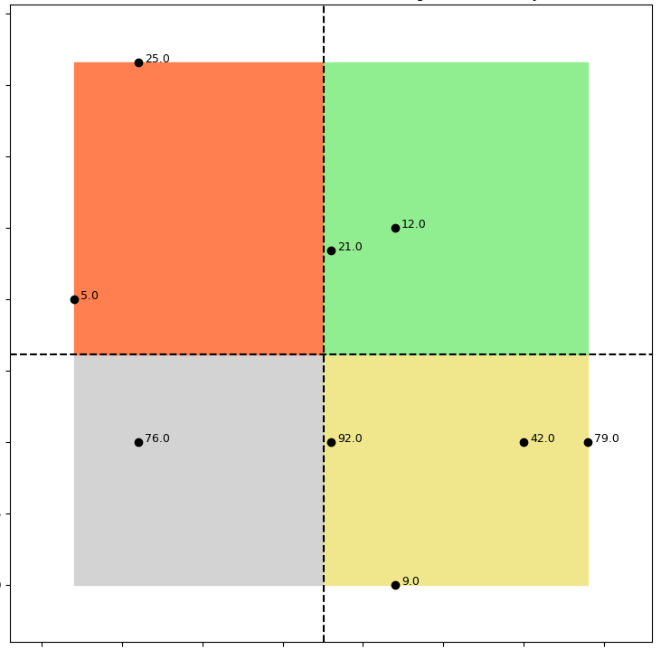
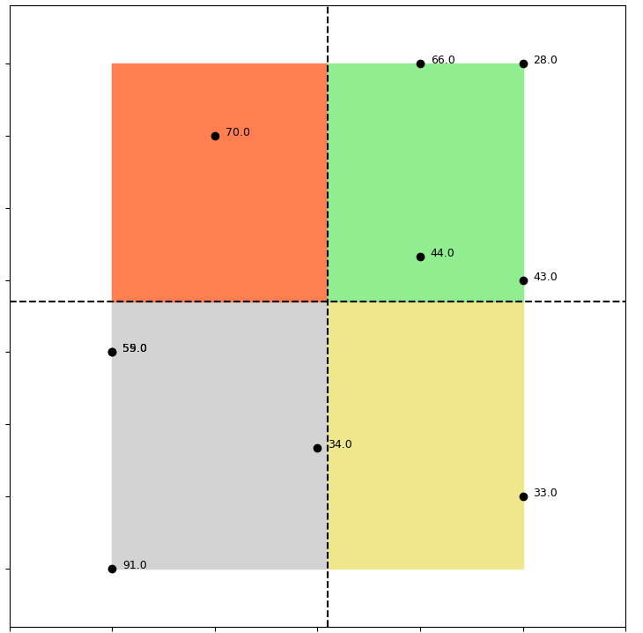
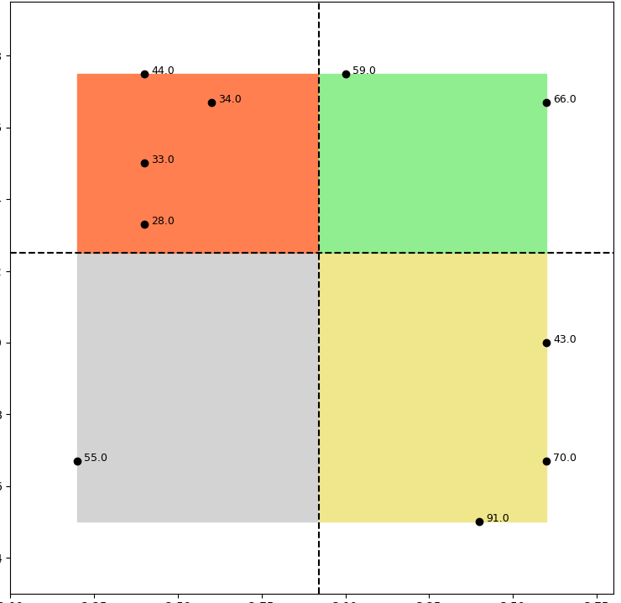
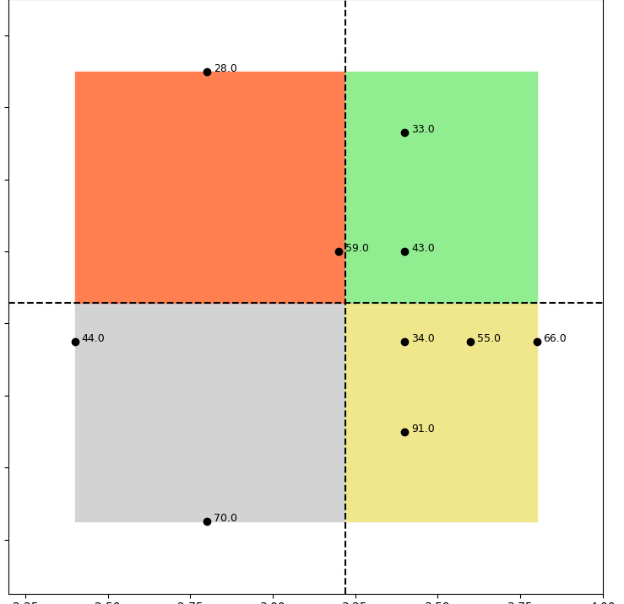
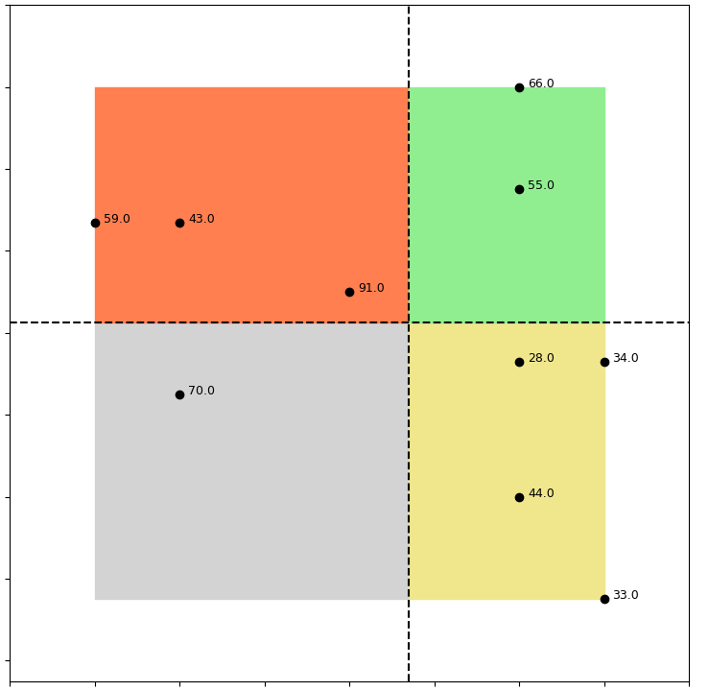
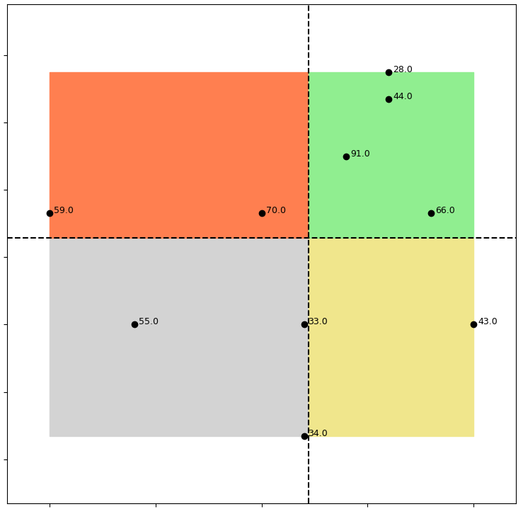
Importance
Means to Use
Method to Use
Desire to Use
Reasons to Use
5.00
60.0
11.0
4.5
29.0
8.0
19.0
4.5
29.0
19.0
4.00
29.0
4.00
29.0
AI developers
4.75
67.0
65.0
23.0
88.0
AI developers
23.0
26.0
AI developers
4.0
65
23
AI developers
3.75
11.0
88.0
AI developers
3.75
11.0
88.0
Cluster 1
Infrastructure and Integration Barriers
4.0
4.50
64.0
3.5
64.0
60.0
3.50
4.0
64.0
3.50
4.0
64.0
4.25
60.
11
65.0
95.0
48.0
26.0
23.0
95.0
26.0
23.0
95
3.5
60.0
64.0
11.0
3.25
67.0
85.0
3.25
67.0
85.0
4.00
95.0
19.0
95.0
4.0
3.75
48.0
89.0
3.5
48.0
89
88.0
85
3.0
26.0
89.0
3.00
90.0
89
65.0
19.0
3.00
60.0
89
65.0
19
3.50
29.0
2.5
2.5
88.0
85.0
2.75
2.75
3.25
26.0
8.0
67.0
8.0
2.50
2.00
2.25
48.0
8.0
4.00
2.50
48.0
65.0
2.0
2.5
3.0
3.5
4.0
2.00
2.25
2.50
2.75
3.00
3.25
3.50
3.75
4.00
2.75
3.00
3.25
3.50
3.75
4.00
4.25
4.50
2.50
2.75
3.00
3.25
3.50
3.75
2.00
2.25
2.50
2.75
3.00
3.25
3.50
3.75
4.00
AI users
AI users
AI users
AI users
AI users
5.0
14.0
3.8
4.00
17.0
14.0
4.2
50
14
3.0
3.75
56.0
1.0
AI developers
AI developers
3.6
14.0
AI developers
3.75
3.0
AI developers
4.0
AI developers
3.50
87.0
4.5
47.0
3.0
94.0
7.0
56.0
47.0
3.8
17.0
94.0
Cluster 3
Insufficient Adaptability to Clinical Complexity
50.0
3.4
1.0
3.50
49.0
3.6
56.0
3.25
84.0
4.0
87.0
56.0
1.0
3.2
3.25
3.4
3.00
47
3.0
94.0
49.0
82.0
7.0
3.0
50
53.0
56
3
17
3.00
84.0
94
50.0
1.0
3.2
7.0
1.0
2.75
53.0
82.0
17.0
3.5
84.0
2.8
49.0
47.0
87
82
2.75
87.0
82
53
3.0
84.0
53.0
53.0
94.0
49.0
2.50
14.0
7.0
49.0
3.0
2.6
84.0
2.50
2.8
87.0
82.0
2.25
50.0
2.0
2.5
17.0
3.0
3.5
4.0
2.4
2.0
2.5
3.0
3.5
4.0
2.25
2.0
2.5
7.0
3.0
3.5
4.0
2.6
2.00
AI users
AI users
AI users
2.00
2.25
2.50
2.75
3.00
3.25
3.50
3.75
2.00
2.25
2.50
2.75
3.00
3.25
3.50
3.75
AI users
AI users
4.75
86.0
4.50
16.0
27.0
4.50
18.0
3.8
93
AI developers
4.50
18.0
AI developers
4.25
27.0
AI developers
4.0
31.0
AI developers
4.25
AI developers
3.6
27.0
4.25
68.0
4.00
4.00
Cluster 5
Ethical, Legal, Financial, and Privacy Concerns
3.5
72.0
96.0
31.0
3.4
72.0
4.00
93
27.0
62.0
16
3.75
31.0
93.0
72.0
83.0
62
3.75
68.0
86.0
62.0
96.0
3.75
96.0
31.0
3.50
96.0
3.0
18.0
86.0
3.50
27.0
3.2
3.50
72.0
3.25
3.25
96.0
86.0
31.0
16
3.25
3.00
18.0
62.0
68.0
3.00
93.0
62.0
16.0
72
3.0
18.0
68
3.00
83.0
2.75
83
68.0
2.5
93.0
2.8
83.0
2.0
2.5
3.0
3.5
4.0
4.5
2.50
86
2.75
83.0
2.6
1.5
2.0
2.5
3.0
3.5
4.0
1.0
1.5
2.0
2.5
3.0
3.5
2.25
2.50
2.75
3.00
3.25
3.50
3.75
4.00
4.25
2.0
2.5
3.0
3.5
4.0
AI users
AI users
AI users
AI users
AI users
5.2
25.0
5.0
4.75
9.0
4.4
12.0
4.75
25.0
4.50
25.0
AI developers
5.0
AI developers
4.50
AI developers
4.2
25.0
AI developers
4.50
12.0
9.0
AI developers
4.25
4.8
21.0
25.0
4.25
4.00
Cluster 6
Lack of Training and Familiarity with AI Tools
4.25
12.0
3.75
12.0
4.6
42.0
4.00
21.0
4.0
21
4.00
5.0
21.0
3.50
5.0
21.0
4.4
9.0
3.75
79.0
92
3.8
92.0
5.0
3.75
79
3.25
4.2
3.50
42.0
3.6
79.0
3.50
3.00
76.0
92.0
42
79
4.0
76.0
92.0
3.25
5.0
3.4
9.0
76.0
3.25
42.0
92.0
2.75
3.8
79.0
3.00
76.0
42.0
3.00
76.0
2.50
9.0
3.6
3.0
3.2
3.4
3.6
3.8
4.0
4.2
4.4
4.6
2.2
2.4
2.6
2.8
3.0
3.2
3.4
3.6
3.8
3.2
3.0
3.5
4.0
4.5
5.0
2.50
2.75
3.00
3.25
3.50
3.75
4.00
2.50
2.75
3.00
3.25
3.50
3.75
4.00
4.25
AI users
AI users
AI users
4.2
AI users
AI users
5.00
66.0
28.0
3.8
44.0
34.0
59.0
66.0
4.6
28.0
4.0
66.0
3.8
28.0
4.75
70.0
3.6
4.4
33.0
44.0
Cluster 10
Clinical Distrust and Concerns Over AI Decision-Making
AI developers
33.0
AI developers
4.2
3.8
55.0
AI developers
3.6
AI developers
4.50
44.0
3.4
28.0
4.0
59
43.0
AI developers
3.6
59.0
43.0
3.4
59.0
70.0
91.0
66.0
4.25
43.0
3.2
3.8
3.4
91.0
28.0
34.0
3.2
4.00
59.0
3.0
43.0
3.6
44.0
34
55
66
3.2
70.0
3.0
55.0
33.0
43
3.75
34.0
2.8
55.0
70.0
3.4
91.0
3.0
44.0
2.8
3.50
91.0
33.0
2.6
91.0
3.2
70.0
2.8
33.0
2.6
34.0
3.25
3.0
3.2
3.4
3.6
3.8
4.0
4.2
2.4
2.00
2.25
2.50
2.75
3.00
3.25
3.50
3.75
2.25
2.50
2.75
3.00
3.25
3.50
3.75
4.00
2.6
2.8
3.0
3.2
3.4
3.6
3.8
4.0
4.2
4.4
2.0
2.5
3.0
3.5
4.0
AI users
AI users
AI users
AI users
AI users

